Slide 1


Raghavender Rao

Slide 2

Linux system administrators should be proficient in Linux performance monitoring and tuning.
This course session gives a high level overview on how we should approach performance monitoring and tuning in Linux.
To identify system bottlenecks and come up with solutions to fix it, you should understand how various components of Linux works.
For example, how to identify performance related issues like High CPU Load, High memory utilization, high disk io, high swap utilization and different tools & commands used to narrow down the issue etc.,

Slide 3
Course Contents
Introduction about Performance monitoring in Linux
Important four subsystems that needs to be monitored.
CPU
Memory
I/O
Network
Familiar & understanding with CPU Utilization
Like Context switches, Run Queue, CPU utilization & Load Average

Slide 4
Course Contents
Important four subsystems that needs to be monitored.
CPU
Familiar & understanding with CPU Utilization
Like Context switches, Run Queue, CPU utilization & Load Average

Slide 5
Course Contents
Familiar & understanding with Memory Utilization
Familiar & understanding with I/O Analyses
Familiar & understanding with Network Monitoring
Familiar with various Commands to manage performance issues in Linux Servers
top
vmstat
iostat
free
lsof
tcpdump- Network Packet Analyzer

Slide 6

Lab on SAR (System Activities Statistics)
Following are the Linux performance statistics using sar command.
Collective CPU usage
Individual CPU statistics
Memory used and available
Swap space used and available
Overall I/O activities of the system
Individual device I/O activities
Run queue and load average data
Network statistics
Report sar data from a specific time

Slide 7
Lab on tcpdump- Network Packet Analyzer
For example: number of packets received (transmitted) through the network card, statistics of packet failure etc
Lab on lsof - List open files
lsof command used in many Linux/Unix like system that is used to display list of all the open files and the processes.

Slide 8
Linux system administrators should be proficient in Linux performance monitoring and tuning.
This course session gives a high level overview on how we should approach performance monitoring and tuning in Linux.
To identify system bottlenecks and come up with solutions to fix it, you should understand how various components of Linux works.
For example, how to identify performance related issues like High CPU Load, High memory utilization, high disk io, high swap utilization and different tools & commands used to narrow down the issue etc.,

Slide 9
On a very high level, following are the four subsystems that needs to be monitored.
CPU
Memory
I/O
Network

Slide 10
CPU
You should understand the four critical performance metrics for CPU — context switch, run queue, cpu utilization, and load average.
Context Switch
When CPU switches from one process (or thread) to another, it is called as context switch.
However, a higher level of context switching can cause performance issues.

Slide 11
CPU
Context Switch
Linux is a multitasking operating system. Which means the kernel has to switch between processes many times. Although it looks simple, the processor has to do multiple things while doing multitasking. For running multiple processes at the same time(which is very normal) the processor has to do the following things.
Processor needs to save all context information of the current running process, before switching to another process execution. This is very necessary as the processor needs to again switch back to this process later.
The processor has to fetch context information of the new process to process.

Slide 12
CPU
Context Switch
You can view information about your process's context switches in /proc/<pid>/status.
$ pid=307
$ grep ctxt /proc/$pid/status
voluntary_ctxt_switches: 41
nonvoluntary_ctxt_switches: 16
To see these numbers updating continuously, run
$ # Update twice a second.
$ watch -n.5 grep ctxt /proc/$pid/status

Slide 13
CPU
Run Queue
Run queue indicates the total number of active processes in the current queue for CPU.
When CPU is ready to execute a process, it picks it up from the run queue based on the priority of the process.
Please note that processes that are in sleep state, or i/o wait state are not in the run queue.
So, a higher number of processes in the run queue can cause performance issues.

Slide 14
CPU
Cpu Utilization
This indicates how much of the CPU is currently getting used.
This is fairly straight forward, and you can view the CPU utilization from the top command.
100% CPU utilization means the system is fully loaded.
So, a higher %age of CPU utilization will cause performance issues.

Slide 15
CPU
Load Average
This indicates the average CPU load over a specific time period.
On Linux, load average is displayed for the last 1 minute, 5 minutes, and 15 minutes. This is helpful to see whether the overall load on the system is going up or down.
For example, a load average of “0.75 1.70 2.10” indicates that the load on the system is coming down. 0.75 is the load average in the last 1 minute. 1.70 is the load average in the last 5 minutes. 2.10 is the load average in the last 15 minutes.
Please note that this load average is calculated by combining both the total number of process in the queue, and the total number of processes in the uninterruptable task status.

Slide 16
Memory
As you know, RAM is your physical memory. If you have 4GB RAM installed on your system, you have 4GB of physical memory.
Virtual memory = Swap space available on the disk + Physical memory. The virtual memory contains both user space and kernel space.
Using either 32-bit or 64-bit system makes a big difference in determining how much memory a process can utilize.
On a 32-bit system a process can only access a maximum of 4GB virtual memory. On a 64-bit system there is no such limitation.

Slide 17
Swap
Swap space in Linux is used when the amount of physical memory (RAM) is full. If the system needs more memory resources and the RAM is full, inactive pages in memory are moved to the swap space. While swap space can help machines with a small amount of RAM, it should not be considered a replacement for more RAM. Swap space is located on hard drives, which have a slower access time than physical memory.
Swap space can be a dedicated swap partition (recommended), a swap file, or a combination of swap partitions and swap files.

Slide 18
I/O
I/O wait is the amount of time CPU is waiting for I/O. If you see consistent high i/o wait on you system, it indicates a problem in the disk subsystem.
You should also monitor reads/second, and writes/second. This is measured in blocks. i.e number of blocks read/write per second. These are also referred as bi and bo (block in and block out).
tps indicates total transactions per seconds, which is sum of rtps (read transactions per second) and wtps (write transactions per seconds).

Slide 19
Network
A good understanding of TCP/IP concepts is helpful while analyzing any network issues and packet loss using tcpdump utility.
For network interfaces, you should monitor total number of packets (and bytes) received/sent through the interface, number of packets dropped, etc.

Slide 20

Commands to manage performance issues in Linux Servers
Managing performance on Linux systems is a lot easier with a few commands.
Listed below are some of commands including top, vmstat, iostat, free, and sar. They may help in resolving performance issues quickly and easily.

Slide 21
Commands to manage performance issues in Linux Servers
Top
Linux Top command is a performance monitoring program which is used frequently by many system administrators to monitor Linux performance and it is available under many Linux/Unix like operating systems. The top command used to display all the running and active real-time processes in ordered list and updates it regularly. It display CPU usage, Memory usage, Swap Memory, Cache Size, Buffer Size, Process PID, User, Commands and much more. It also shows high memory and cpu utilization of a running processes. The top command is much useful for system administrator to monitor and take correct action when required. Let’s see top command in action.

Slide 22
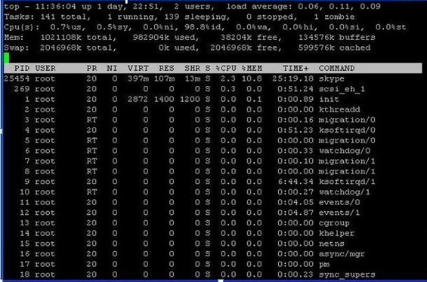

Slide 23
Commands to manage performance issues in Linux Servers
vmstat
The ‘vmstat’ command gives a snapshot of current CPU, IO, processes and memory usage. Similar to the top command, it dynamically updates and can be executed with this command:
$ vmstat 10
# vmstat
procs -----------memory---------- ---swap-- -----io---- --system-- -----cpu-----
r b swpd free inact active si so bi bo in cs us sy id wa st
1 0 0 810420 97380 70628 0 0 115 4 89 79 1 6 90 3 0

Slide 24
Commands to manage performance issues in Linux Servers
sar
Use the ‘sar’ command line tool to collect, view and record performance data. This command is considerably more sophisticated than all the commands discussed above. It can collect and display data over longer periods.

Slide 25
Commands to manage performance issues in Linux Servers
iostat
The ‘iostat’ command offers three reports. These are CPU utilization, device utilization, and network file system utilization. In case of running the command without options,it will display all three reports. The individual reports can be specified with the -c, -d and -h switches respectively.

Slide 26
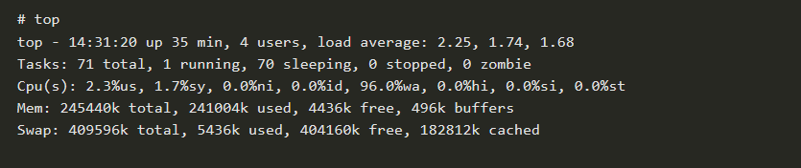
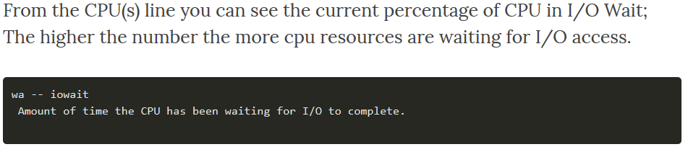
Commands to manage performance issues in Linux Servers
Iostat
To identify whether I/O is causing system slowness you can use several commands but the easiest is the unix command top.

Slide 27
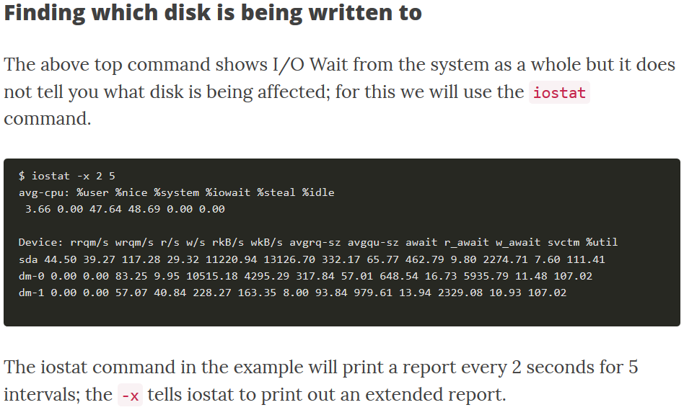

Slide 28
Commands to manage performance issues in Linux Servers
free
The ‘free’ command shows memory statistics for both main memory and swap. A total memory amount can be displayed by specifying the -t switch. The amounts in bytes can also be displayed by specifying the -b switch and megabytes using the -m switch (it displays in kilobytes by default).
Free can also be run continuously using the -s switch with a delay specified in seconds:
$ free -s 5

Slide 29
Commands to manage performance issues in Linux Servers
free

Slide 30
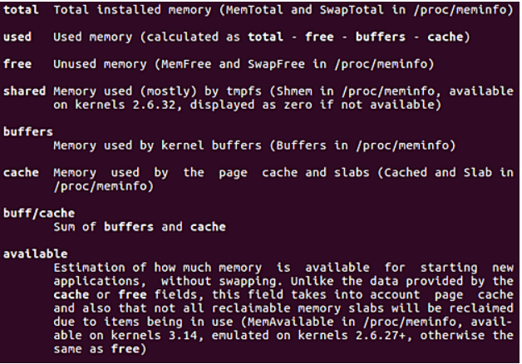
Commands to manage performance issues in Linux Servers

Slide 31
Commands to manage performance issues in Linux Servers
Lsof – List Open Files
Lsof command used in many Linux/Unix like system that is used to display list of all the open files and the processes. The open files included are disk files, network sockets, pipes, devices and processes. One of the main reason for using this command is when a disk cannot be unmounted and displays the error that files are being used or opened. With this commmand you can easily identify which files are in use. The most common format for this command is.
$ lsof

Slide 32
Commands to manage performance issues in Linux Servers
Tcpdump – Network Packet Analyzer
Tcpdump one of the most widely used command-line network packet analyzer or packets sniffer program that is used capture or filter TCP/IP packets that received or transferred on a specific interface over a network. It also provides a option to save captured packages in a file for later analysis. tcpdump is almost available in all major Linux distributions.

Slide 33
SAR (System Activities Statistics)
Following are the Linux performance statistics using sar.
Collective CPU usage
Individual CPU statistics
Memory used and available
Swap space used and available
Overall I/O activities of the system
Individual device I/O activities
Run queue and load average data
Network statistics
Report sar data from a specific time

Slide 34
SAR (System Activities Statistics)
Using sar you can monitor performance of various Linux subsystems (CPU, Memory, I/O, Network Statistics) in real time.
Using sar, you can also collect all performance data on an on-going basis, store them, and do historical analysis to identify bottlenecks.

Slide 35
SAR (System Activities Statistics)
Install and Configure Sysstat
First, make sure the latest version of sar is available on your system. Install it using any one of the following methods depending on your distribution.
sudo apt-get install sysstat
(or)
yum install sysstat
(or)
rpm -ivh sysstat-10.0.0-1.i586.rpm

Slide 36
SAR (System Activities Statistics)
Install Sysstat Package
Once installed, verify the sar version using “sar -V”. Version 10 is the current stable version of sysstat.
$ sar -V

Slide 37
SAR (System Activities Statistics)
1. CPU Usage of ALL CPUs (sar -u)
This gives the cumulative real-time CPU usage of all CPUs. “1 3” reports for every 1 seconds a total of 3 times. Most likely you’ll focus on the last field “%idle” to see the cpu load.

Slide 38
SAR (System Activities Statistics)
1. CPU Usage of ALL CPUs (sar -u)
LinuxGuru@Server#sar -u 1 2
Linux 2.6.18-404.el5 04/09/17
10:53:47 CPU %user %nice %system %iowait %steal %idle
10:53:48 all 2.04 0.00 2.04 0.00 0.00 95.92
10:53:49 all 0.00 0.00 0.00 0.00 0.00 100.00
Average: all 1.02 0.00 1.02 0.00 0.00 97.97

Slide 39
SAR (System Activities Statistics)
1. CPU Usage of ALL CPUs (sar -u)
sar -u Displays CPU usage for the current day that was collected until that point.
sar -u 1 3 Displays real time CPU usage every 1 second for 3 times.
sar -u ALL Same as “sar -u” but displays additional fields.
sar -u ALL 1 3 Same as “sar -u 1 3” but displays additional fields.
sar -u -f /var/log/sa/sa10 Displays CPU usage for the 10day of the month from the sa10 file.

Slide 40
SAR (System Activities Statistics)
2. CPU Usage of Individual CPU or Core (sar -P)
If you have 4 Cores on the machine and would like to see what the individual cores are doing, do the following.
“-P ALL” indicates that it should displays statistics for ALL the individual Cores.
In the following example under “CPU” column 0, 1, 2, and 3 indicates the corresponding CPU core numbers.

Slide 41
SAR (System Activities Statistics)
2. CPU Usage of Individual CPU or Core (sar -P)
LinuxGuru@Server#sar -P ALL 1 1
Linux 2.6.18-404.el5 04/09/17
10:38:19 CPU %user %nice %system %iowait %steal %idle
10:38:20 all 0.00 0.00 0.00 0.00 0.00 100.00
10:38:20 0 0.00 0.00 0.00 0.00 0.00 100.00
Average: CPU %user %nice %system %iowait %steal %idle
Average: all 0.00 0.00 0.00 0.00 0.00 100.00
Average: 0 0.00 0.00 0.00 0.00 0.00 100.00

Slide 42
SAR (System Activities Statistics)
3. Memory Free and Used (sar -r)
LinuxGuru@Server#sar -r 1 3
Linux 2.6.18-404.el5 04/09/17
10:38:58 kbmemfree kbmemused %memused kbbuffers kbcached kbswpfree kbswpused %swpused kbswpcad
10:38:59 45148 3998636 98.88 524492 2997728 5996424 112 0.00 0
10:39:00 45148 3998636 98.88 524492 2997728 5996424 112 0.00 0
10:39:01 45212 3998572 98.88 524500 2997720 5996424 112 0.00 0
Average: 45169 3998615 98.88 524495 2997725 5996424 112 0.00 0
LinuxGuru@Server#

Slide 43
SAR (System Activities Statistics)
Following are few variations:
Sar –P ALL –f sa(datefile)
Sar –u –f sa(datefile)
sar -P ALL Displays CPU usage broken down by all cores for the current day.
sar -P ALL 1 3 Displays real time CPU usage for ALL cores every 1 second for 3 times (broken down by all cores).
sar -P 1 Displays CPU usage for core number 1 for the current day.
sar -P 1 1 3 Displays real time CPU usage for core number 1, every 1 second for 3 times.
sar -P ALL -f /var/log/sa/sa10 Displays CPU usage broken down by all cores for the 10day day of the month from sa10 file.

Slide 44
SAR (System Activities Statistics)
3. Memory Free and Used (sar -r)
This reports the memory statistics. “1 3” reports for every 1 seconds a total of 3 times. Most likely you’ll focus on “kbmemfree” and “kbmemused” for free and used memory.

Slide 45
SAR (System Activities Statistics)
3. Memory Free and Used (sar -r)
Following are few variations:
sar -r
sar -r 1 3
sar -r -f /var/log/sa/sa10

Slide 46
SAR (System Activities Statistics)
4. Overall I/O Activities (sar -b)
This reports I/O statistics. “1 3” reports for every 1 seconds a total of 3 times.
Following fields are displays in the example below.
tps – Transactions per second (this includes both read and write)
rtps – Read transactions per second
wtps – Write transactions per second
bread/s – Bytes read per second
bwrtn/s – Bytes written per second

Slide 47
SAR (System Activities Statistics)
LinuxGuru@Server#sar -b 1 3
Linux 2.6.18-404.el5 04/09/17
10:40:03 tps rtps wtps bread/s bwrtn/s
10:40:04 0.00 0.00 0.00 0.00 0.00
10:40:05 0.00 0.00 0.00 0.00 0.00
10:40:06 98.99 0.00 98.99 0.00 2133.33
Average: 32.78 0.00 32.78 0.00 706.35

Slide 48
SAR (System Activities Statistics)
Following are few variations:
sar -b
sar -b 1 3
sar -b -f /var/log/sa/sa10
Note: Use “sar -v” to display number of inode handlers, file handlers, and pseudo-terminals used by the system.

Slide 49
SAR (System Activities Statistics)
5. Individual Block Device I/O Activities (sar -d)
To identify the activities by the individual block devices (i.e a specific mount point, or LUN, or partition), use “sar -d”

Slide 50
SAR (System Activities Statistics)
LinuxGuru@Server#sar -d 1 1
Linux 2.6.18-404.el5 04/09/17
10:41:07 DEV tps rd_sec/s wr_sec/s avgrq-sz avgqu-sz await svctm %util
10:41:08 dev8-0 2.00 0.00 176.00 88.00 0.00 1.00 1.00 0.20
10:41:08 dev8-1 0.00 0.00 0.00 0.00 0.00 0.00 0.00 0.00
10:41:08 dev8-2 2.00 0.00 176.00 88.00 0.00 1.00 1.00 0.20
10:41:08 dev8-16 0.00 0.00 0.00 0.00 0.00 0.00 0.00 0.00
10:41:08 dev8-17 0.00 0.00 0.00 0.00 0.00 0.00 0.00 0.20

Slide 51
SAR (System Activities Statistics)
In the above example “DEV” indicates the specific block device.
For example: “dev8-1” means a block device with 8 as major number, and 1 as minor number.

Slide 52
SAR (System Activities Statistics)
The device name (DEV column) can display the actual device name (for example: sda, sda1, sdb1 etc.,), if you use the -p option (pretty print) as shown below.
LinuxGuru@Server#sar -p -d 1 1
Linux 2.6.18-404.el5 04/09/17
10:42:18 DEV tps rd_sec/s wr_sec/s avgrq-sz avgqu-sz await svctm %util
10:42:19 sda 0.00 0.00 0.00 0.00 0.00 0.00 0.00 0.00
10:42:19 sda1 0.00 0.00 0.00 0.00 0.00 0.00 0.00 0.00
10:42:19 sda2 0.00 0.00 0.00 0.00 0.00 0.00 0.00 0.00
10:42:19 sdb 0.00 0.00 0.00 0.00 0.00 0.00 0.00 0.00
10:42:19 sdb1 0.00 0.00 0.00 0.00 0.00 0.00 0.00 0.00
10:42:19 sdc 0.00 0.00 0.00 0.00 0.00 0.00 0.00 0.00

Slide 53
SAR (System Activities Statistics)
Following are few variations:
sar -d
sar -d 1 3
sar -d -f /var/log/sa/sa10
sar -p -d

Slide 54
SAR (System Activities Statistics)
6. Reports run queue and load average (sar -q)
This reports the run queue size and load average of last 1 minute, 5 minutes, and 15 minutes. “1 3” reports for every 1 seconds a total of 3 times.

Slide 55
Linux Performance Monitoring and Tuning Introduction
SAR (System Activities Statistics)
LinuxGuru@Server#sar -q 1 3
Linux 2.6.18-404.el5 04/09/17
10:42:56 runq-sz plist-sz ldavg-1 ldavg-5 ldavg-15
10:42:57 0 296 0.00 0.00 0.00
10:42:58 0 296 0.00 0.00 0.00
10:42:59 0 296 0.00 0.00 0.00
Average: 0 296 0.00 0.00 0.00
LinuxGuru@Server#

Slide 56
Linux Performance Monitoring and Tuning Introduction
SAR (System Activities Statistics)
Note: The “blocked” column displays the number of tasks that are currently blocked and waiting for I/O operation to complete.
Following are few variations:
sar -q
sar -q 1 3
sar -q -f /var/log/sa/sa10

Slide 57
Linux Performance Monitoring and Tuning Introduction
SAR (System Activities Statistics)
7. Report network statistics (sar -n)
This reports various network statistics. For example: number of packets received (transmitted) through the network card, statistics of packet failure etc.,. “1 3” reports for every 1 seconds a total of 3 times.

Slide 58
Linux Performance Monitoring and Tuning Introduction
SAR (System Activities Statistics)
KEYWORD can be one of the following:
DEV – Displays network devices vital statistics for eth0, eth1, etc.,
EDEV – Display network device failure statistics
NFS – Displays NFS client activities
NFSD – Displays NFS server activities
SOCK – Displays sockets in use for IPv4
IP – Displays IPv4 network traffic
EIP – Displays IPv4 network errors
ICMP – Displays ICMPv4 network traffic
TCP – Displays TCPv4 network traffic
ETCP – Displays TCPv4 network errors
UDP – Displays UDPv4 network traffic
SOCK6, IP6, EIP6, ICMP6, UDP6 are for IPv6
ALL – This displays all of the above information. The output will be very long.

Slide 59
Linux Performance Monitoring and Tuning Introduction
SAR (System Activities Statistics)
$ sar -n DEV 1 1
LinuxGuru@Server#sar -n DEV 1 1
Linux 2.6.18-404.el5 04/09/17
10:45:26 IFACE rxpck/s txpck/s rxbyt/s txbyt/s rxcmp/s txcmp/s rxmcst/s
10:45:27 lo 0.00 0.00 0.00 0.00 0.00 0.00 0.00
10:45:27 eth0 7.07 4.04 1245.45 363.64 0.00 0.00 0.00
10:45:27 sit0 0.00 0.00 0.00 0.00 0.00 0.00 0.00
Average: IFACE rxpck/s txpck/s rxbyt/s txbyt/s rxcmp/s txcmp/s rxmcst/s
Average: lo 0.00 0.00 0.00 0.00 0.00 0.00 0.00
Average: eth0 7.07 4.04 1245.45 363.64 0.00 0.00 0.00
Average: sit0 0.00 0.00 0.00 0.00 0.00 0.00 0.00

Slide 60
Linux Performance Monitoring and Tuning Introduction
SAR (System Activities Statistics)
8. Report Sar Data Using Start Time (sar -s)
When you view historic sar data from the /var/log/sa/saXX file using “sar -f” option, it displays all the sar data for that specific day starting from 12:00 a.m for that day.
Using “-s hh:mi:ss” option, you can specify the start time. For example, if you specify “sar -s 10:00:00”, it will display the sar data starting from 10 a.m (instead of starting from midnight) as shown below.
You can combine -s option with other sar option.

Slide 61
Linux Performance Monitoring and Tuning Introduction
SAR (System Activities Statistics)
For example, to report the load average on 26th of this month starting from 10 a.m in the morning, combine the -q and -s option as shown below.
$ sar -q -f /var/log/sa/sa23 -s 10:00:01
Linux 2.6.18-194.el5PAE (dev-db) 03/26/2011 _i686_ (8 CPU)
10:00:01 AM runq-sz plist-sz ldavg-1 ldavg-5 ldavg-15 blocked
10:10:01 AM 0 127 2.00 3.00 5.00 0
10:20:01 AM 0 127 2.00 3.00 5.00 0
...
11:20:01 AM 0 127 5.00 3.00 3.00 0
12:00:01 PM 0 127 4.00 2.00 1.00 0

Slide 62
Linux Performance Monitoring and Tuning Introduction
SAR (System Activities Statistics)
Sample Performance Issue reported
CPU Utilization:
# sar -f /var/log/sa/sa11 -u 2 -s 06:30:00 -e 07:30:00
Linux 2.6.32-431.20.3.el6.s390x 11/10/16 _s390x_ (1 CPU)
06:30:01 CPU %user %nice %system %iowait %steal %idle
06:40:01 all 28.61 0.02 3.13 0.09 5.05 63.12
06:50:01 all 30.17 0.00 3.26 0.04 5.43 61.10
07:00:01 all 31.32 0.00 6.91 18.85 5.21 37.71 <== iowait is little bit high
07:10:01 all 40.83 0.00 13.10 13.98 5.56 26.53 <== iowait is little bit high
07:20:01 all 34.33 0.00 3.63 0.09 7.13 54.82
Average: all 33.05 0.00 6.01 6.61 5.67 48.66

Slide 63
Linux Performance Monitoring and Tuning Introduction
SAR (System Activities Statistics)
Sample Performance Issue reported
# sar -f /var/log/sa/sa11 -r 2 -s 05:30:00 -e 07:00:00
Linux 2.6.32-431.20.3.el6.s390x 11/10/16 _s390x_ (1 CPU)
05:30:01 kbmemfree kbmemused %memused kbbuffers kbcached kbcommit %commit
05:40:01 576056 3534540 85.99 288032 2406268 2959556 29.97
05:50:01 579432 3531164 85.90 288640 2402832 2958840 29.97
06:00:01 570692 3539904 86.12 289300 2403720 2974996 30.13
06:10:01 576428 3534168 85.98 289968 2404044 2959556 29.97
06:20:01 576688 3533908 85.97 290568 2403600 2958840 29.97
06:30:01 575272 3535324 86.01 291212 2402080 2970632 30.09
06:40:01 577636 3532960 85.95 291856 2400944 2959556 29.97
06:50:01 577796 3532800 85.94 292536 2400664 2958840 29.97

Slide 64
Linux Performance Monitoring and Tuning Introduction
SAR (System Activities Statistics)
Sample Performance Issue reported
Disk Utilization:
=================
[root@nc2z01lx012 ~]# sar -f /var/log/sa/sa11 -p -d 1 -s 06:30:00 -e 07:30:00 | grep -i swap
06:30:01 DEV tps rd_sec/s wr_sec/s avgrq-sz avgqu-sz await svctm %util
06:40:01 vg_root-lv_swap 0.00 0.00 0.00 0.00 0.00 0.00 0.00 0.00
06:50:01 vg_root-lv_swap 0.00 0.00 0.00 0.00 0.00 0.00 0.00 0.00
07:00:01 vg_root-lv_swap 0.12 0.75 0.25 8.00 0.00 15.33 2.40 0.03
07:10:01 vg_root-lv_swap 0.12 0.21 0.72 8.00 0.00 17.29 6.57 0.08
07:20:01 vg_root-lv_swap 0.00 0.00 0.01 8.00 0.00 10.00 10.00 0.00
Average: vg_root-lv_swap 0.05 0.19 0.20 8.00 0.00 16.23 4.45 0.00
disk await is high during the same period of time and the disk is swap disk. It is trying to access the swap disk but unable to get it. So the swap utilization is normal but unable to get the swap disk to swapin swap out.

Slide 65
Tcpdump
tcpdump is a most powerful and widely used command-line packets sniffer or package analyzer tool which is used to capture or filter TCP/IP packets that received or transferred over a network on a specific interface.
It is available under most of the Linux/Unix based operating systems. tcpdump also gives us a option to save captured packets in a file for future analysis.

Slide 66
Tcpdump
1. Capture Packets from Specific Interface
# tcpdump -i eth0
2. Capture Only N Number of Packets
When you run tcpdump command it will capture all the packets for specified interface, until you Hit cancel button. But using -c option, you can capture specified number of packets. The below example will only capture 6 packets.
# tcpdump -c 5 -i eth0

Slide 67
Tcpdump
3. Print Captured Packets in ASCII
The below tcpdump command with option -A displays the package in ASCII format. It is a character-encoding scheme format.
# tcpdump -A -i eth0
4. Display Available Interfaces
To list number of available interfaces on the system, run the following command with -D option.
# tcpdump -D
1.eth0
2.eth1

Slide 68
Tcpdump
5. Capture and Save Packets in a File
As we said, that tcpdump has a feature to capture and save the file in a .pcap format, to do this just execute command with -w option.
# tcpdump -w 0001.pcap -i eth0
6. Read Captured Packets File
To read and analyze captured packet 0001.pcap file use the command with -r option, as shown below.
# tcpdump -r 0001.pcap

Slide 69
Tcpdump
7. Capture IP address Packets
To capture packets for a specific interface, run the following command with option -n.
# tcpdump -n -i eth0
8. Capture only TCP Packets.
To capture packets based on TCP port, run the following command with option tcp.
# tcpdump -i eth0 tcp

Slide 70
Tcpdump
9. Capture Packet from Specific Port
Let’s say you want to capture packets for specific port 22, execute the below command by specifying port number 22 as shown below.
# tcpdump -i eth0 port 22
10.To collect the packet details on eth0
# tcpdump -n -i eth0 -s 0 -w /tmp/ppte-esi-eth0.cap
Press Cntrl+C to stop

Slide 71
Tcpdump
11. tcpdump on particular host IP:
tcpdump -i eth0 -s 0 host 10.165.107.73

Slide 72
lsof
It is easy to remember lsof command if you think of it as “ls + of”, where ls stands for list, and of stands for open files.
It is a command line utility which is used to list the information about the files that are opened by various processes. In unix, everything is a file, ( pipes, sockets, directories, devices, etc.). So by using lsof, you can get the information about any opened files.

Slide 73
High CPU Utilization
Below are commands which can be used to find out biggest cpu consuming processes
top
ps –eo pmem,pcpu,pid,args | tail –n +2|sort –rnk 1|head

Slide 74
High Memory Utilization
Below are commands which can be used to find out biggest memory consuming processes
top
ps –eo pmem,pcpu,pid,args | tail –n +2|sort –rnk 2|head

Slide 75
Swap
Swap space in Linux is used when the amount of physical memory (RAM) is full. If the system needs more memory resources and the RAM is full, inactive pages in memory are moved to the swap space. While swap space can help machines with a small amount of RAM, it should not be considered a replacement for more RAM. Swap space is located on hard drives, which have a slower access time than physical memory.
Swap space can be a dedicated swap partition (recommended), a swap file, or a combination of swap partitions and swap files.

Slide 76
How to Increase Swap in Linux
There are two methods we can create the swap space
Using swap partition
Using swap file

Slide 77
How to Increase Swap in Linux
There are two methods we can create the swap space
Using swap partition
Using swap file

Slide 78

END of this Course Module.
Thanks

